Slide 1

LIBRARY MANAGEMENT SYSTEM
Presented By :
Samiul Sazid Sammo (2101049)
Mohammad Abu Sufian (2201051)
BDU | 2025

Slide 2
1
INTRODUCTION
The Library Management System (LMS) is designed to manage the operations of a library in an organized and efficient manner. This system simplifies the process of maintaining records of books, members, and transactions (like reserving and returning books), ensuring smooth library operations. It allows librarians to manage book inventories, track member activities, and record transactions, offering a comprehensive solution for both administrators and members.

Slide 3

2
OBJECTIVE
Obtain a database-driven system that manages book inventory, member information, Payments, and transactions.
To provide a secure login system for admins and members.
Ensures accurate tracking of book reservations and returns.
offer a user-friendly interface for both members and library staff to interact with the system.
To offer a nice and attractive User Interface
To maintain data consistency and ensure efficient data retrieval from database.

Slide 4
PROJECT DESCRIPTION
3
Admin Features
User Features
See User List
Add books
Add Admins
Admin Profile and Information
Record User Transections
Search Books
Due Payments
User Profile and Information
MY Transections
Search Books
See Authors
Payments
Safe Logout
2025

Slide 5
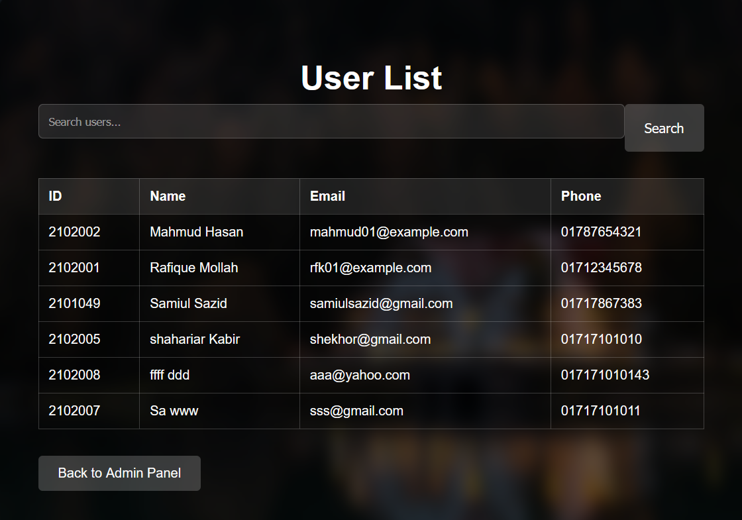
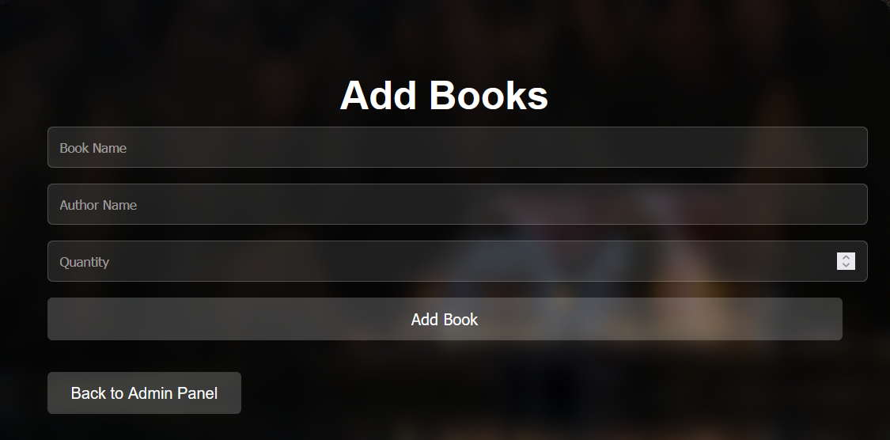
Admin Functionality
4
See User List
Add books

Slide 6
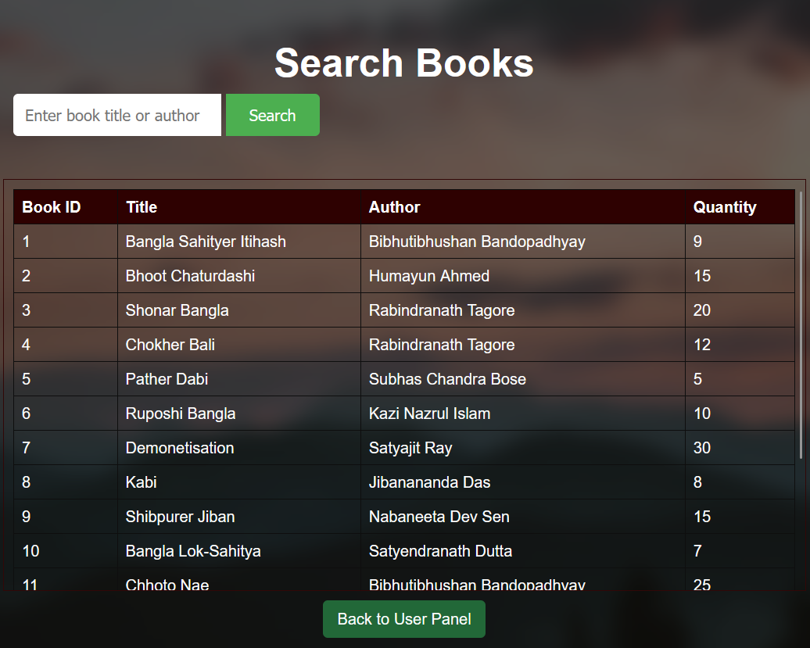
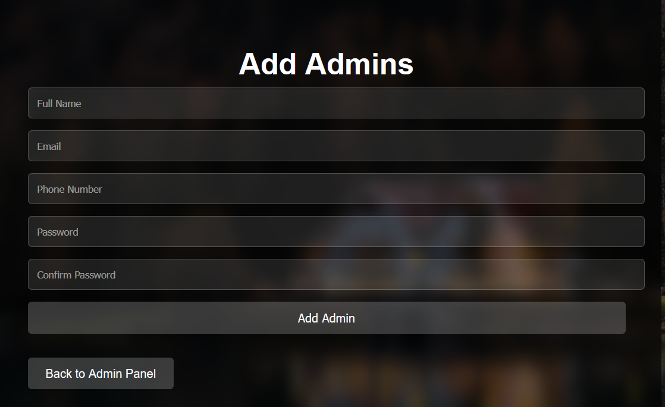
Admin Functionality
5
See Books
Add Admins

Slide 7
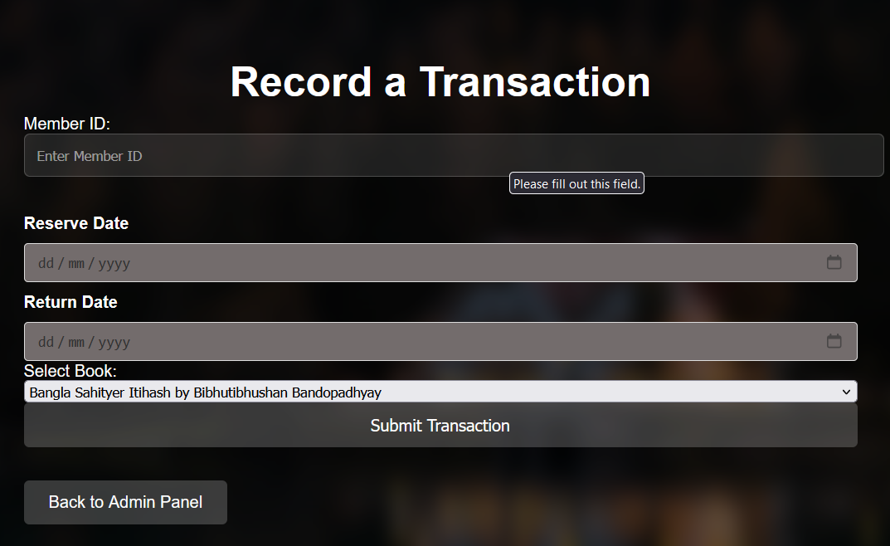
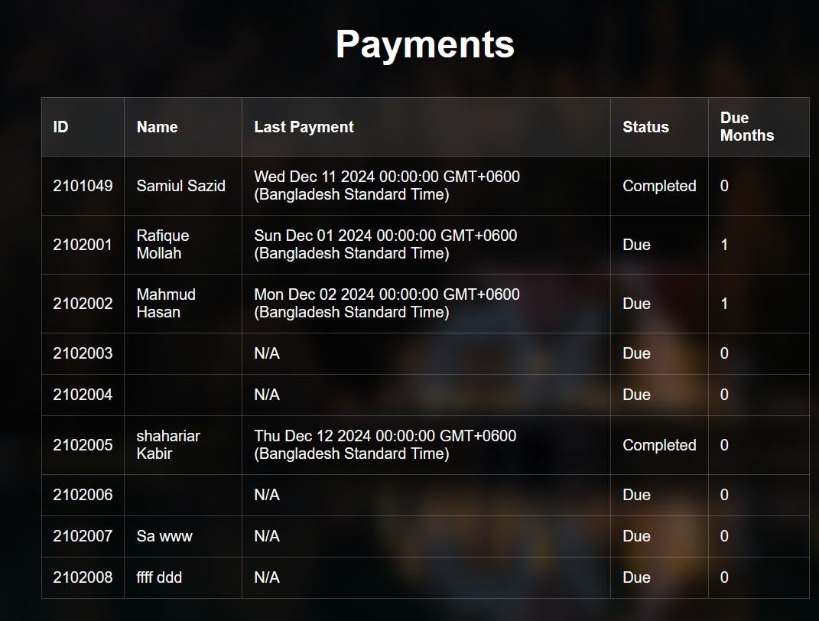
Admin Functionality
6
Record Transaction
Payments

Slide 8
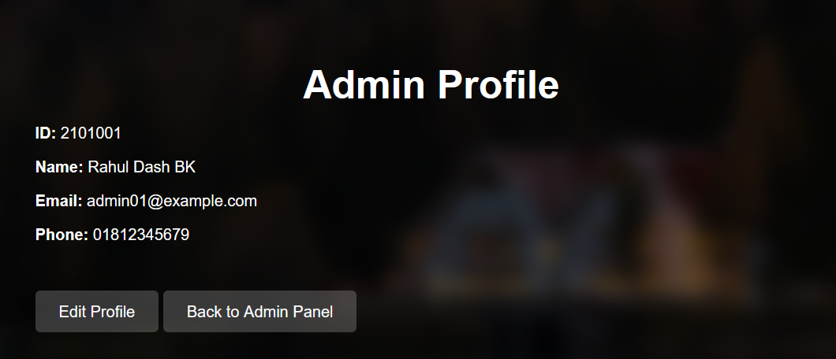
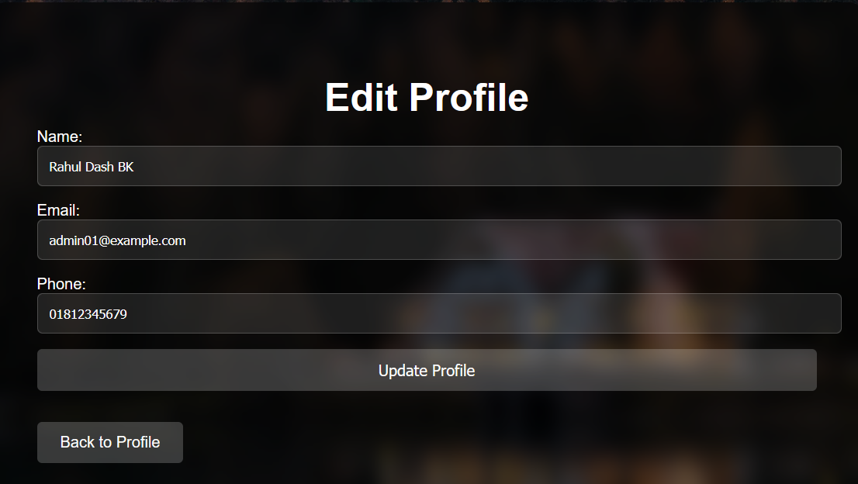
Admin Functionality
7
Admin Profile
Edit Profile

Slide 9
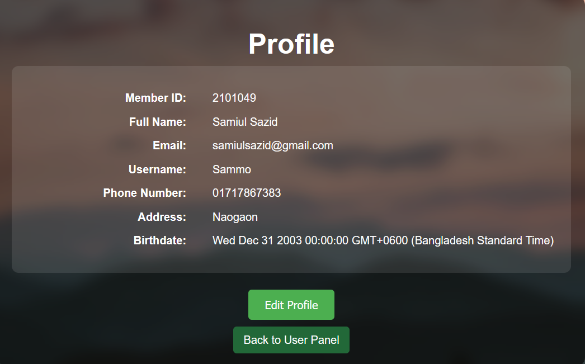
User Functionality
8
User Profile
Edit Profile

Slide 10
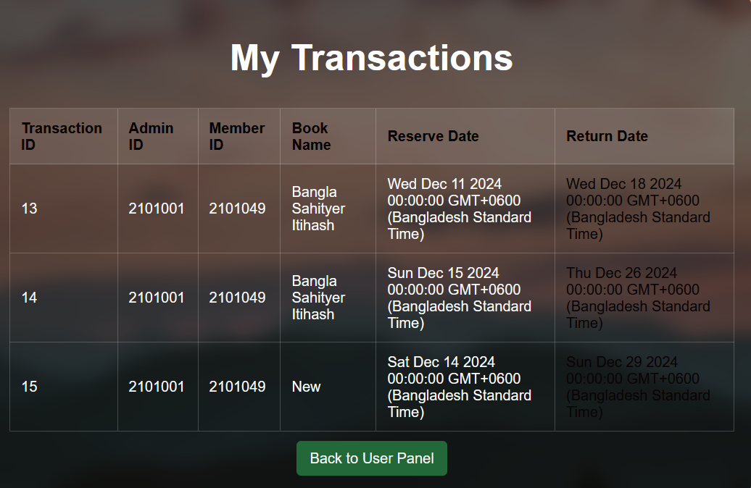
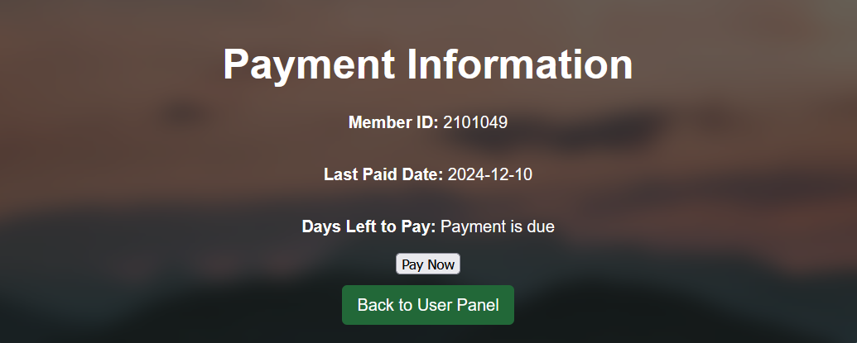
User Functionality
9
My transactions
Payments

Slide 11
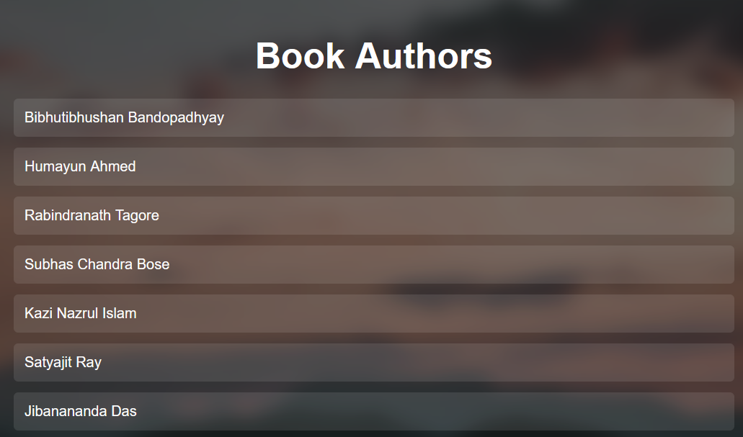
User Functionality
10
See Authors

Slide 12




Used Languages
11
Frontend
Backend
Database
Modules
Express JS,
HTML,
CSS
Node.js,
Express.js
MySQL
Npm
MySql2
Nodemon

Slide 13
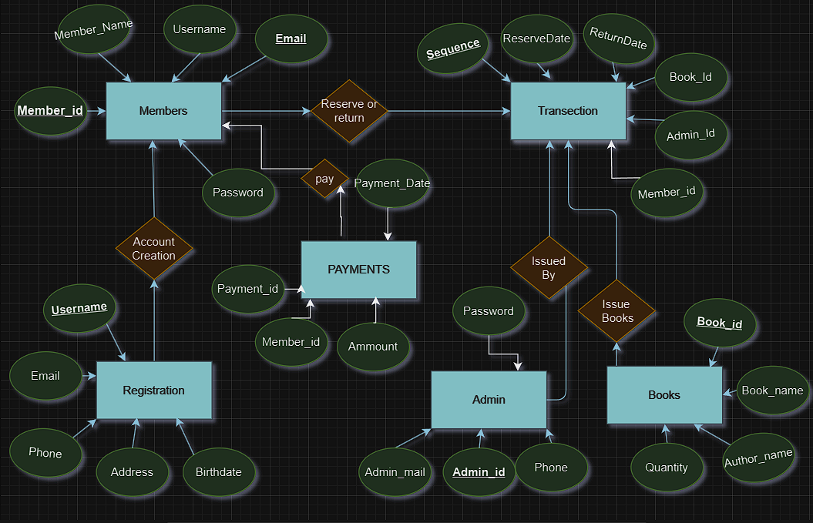
ER DIAGRAM
12

Slide 14
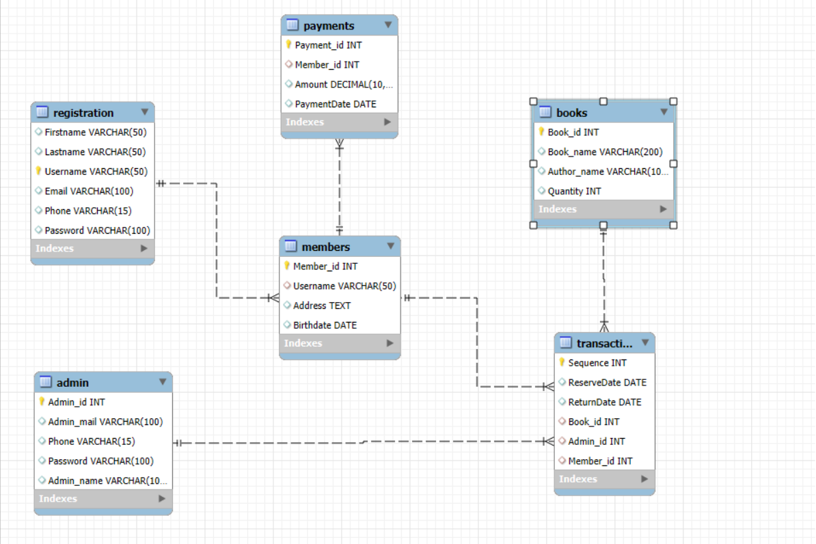
Schema Diagram
13

Slide 15

Tables Info
14
Registration Table:
Primary Key: Username
Foreign Key: Email (linked to Login.Email)
Attributes: Username, Email, Phone, Address, Birthdate
Payments Table:
Primary Key: Payment_id
Attributes: Member_id(int), Ammount(int), Payment_date(date)
Admin Table: Primary Key: Admin id
Attributes: Admin id, Admin mail, Phone , Admin_name
Books Table: Primary Key: Book id
Attributes: Book id, Book name, Author name, Quantity
Members Table: Primary Key: Member id
Foreign Key: Username
Attributes: Member id, Member name, Username
Transaction Table: Primary Key: Sequence
Foreign Keys: Book id (linked to Books.Book id), Admin id (linked to Admin.Admin id), Member id (linked to Members.Member id)
Attributes: Sequence, ReserveDate, ReturnDate, Book id, Admin id, Member id

Slide 16
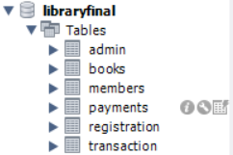
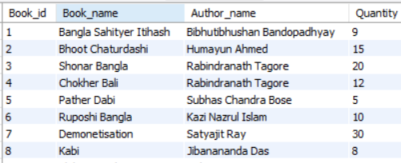
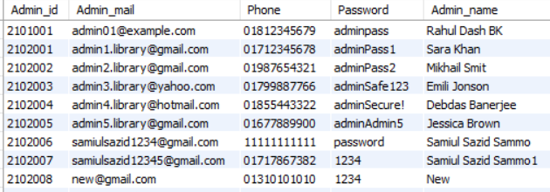
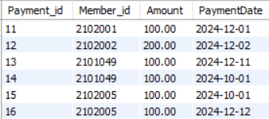
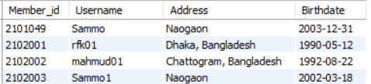
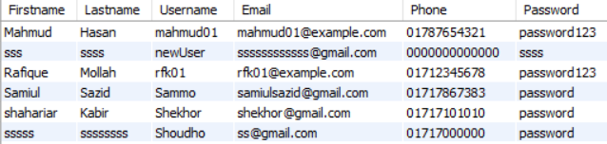
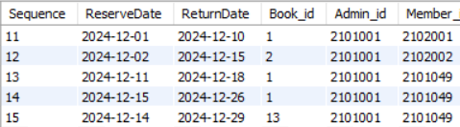
Database Implementation
13
Books Table:
Admin Table:
Payments Table:
Members Table:
Registration Table:
Transaction Table:

Slide 17


13
Future Enhancements
Otp verification
Email Notifications for Payments and Reservations.
Password Hashing for Security
Buy hosting and get our website online
Add Authentic Payment System

Slide 18
THANK YOU
Presented By :
Samiul Sazid Sammo (2101049)
Mohammad Abu Sufian (2201051)
2025

